Slide 1
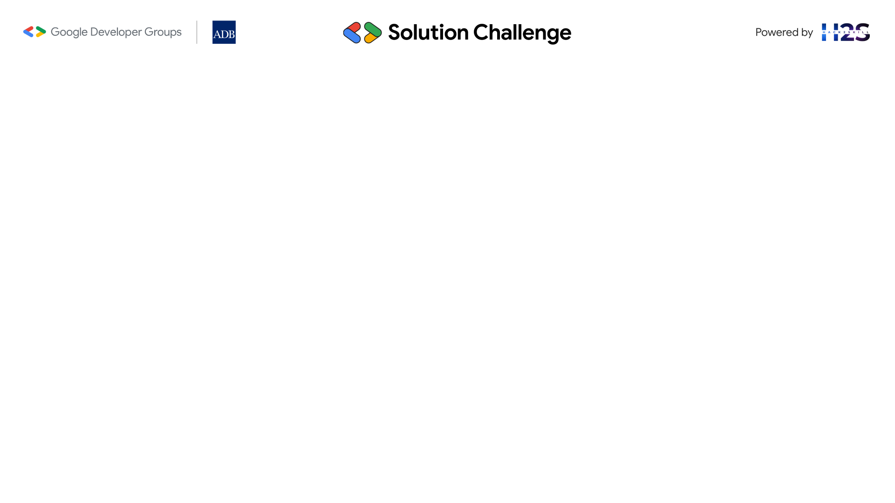
Guidelines
Kindly use the given template for submitting your project (Make a copy of the template).
One team is only required to submit one project.
The ideal size of the presentation should not be more than 10-12 slides.
You are welcome to add as many POCs and design concepts to support your project.
It is mandatory to use Gemini APIs while building your prototype.
In case of queries, kindly reach out to us at apacsolutionchallenge@hack2skill.com

Slide 2

Team Details
Team name:
Team leader name:
Problem Statement:

Slide 3
Brief about your solution

Slide 4
Opportunities
How different is it from any of the other existing ideas?
How will it be able to solve the problem?
USP of the proposed solution

Slide 5
List of features offered by the solution

Slide 6
Process flow diagram or Use-case diagram

Slide 7
Wireframes/Mock diagrams of the proposed solution

Slide 8
Architecture diagram of the proposed solution

Slide 9
Technologies to be used in the solution
(Mandatory to integrate Gemini APIs)

Slide 10
Estimated implementation cost (optional)

Slide 11
Snapshots of the prototype

Slide 12
Additional Details/Future Development (if any)

Slide 13
Provide links to your:
Demo video link (3 minutes)
Working prototype link

Slide 15


